Slide 1
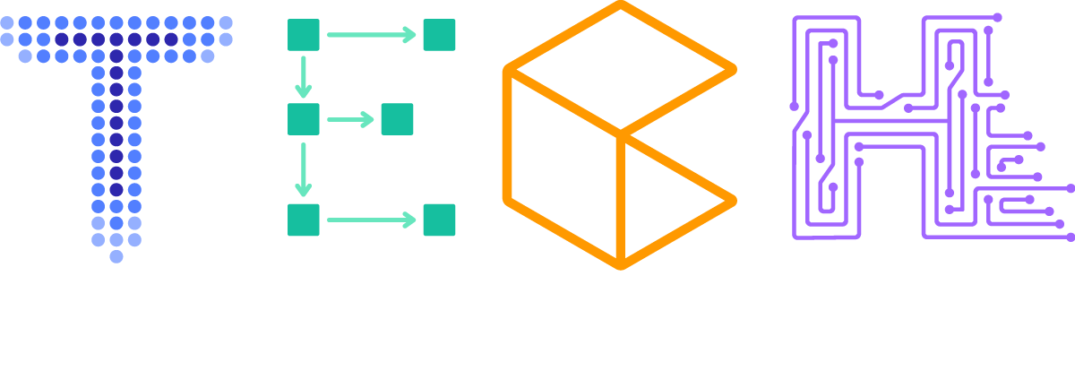
Textual Madness
NLP progress, and why attention is all you need
Olivier Cruchant & Laurens ten Cate
cruchant@amazon.fr & laurcate@amazon.nl
Specialist SA & ProServe Data Scientist
30-09-2019

Slide 2
Agenda
Word representation strategies
BPE
L2-norm and the semantic limit
word2vec
2. Attention is all you need
Attention and self-attention
Transformer architecture
BERT
GPT-2
roBERTa

Slide 3


Slide 4
Tokenization – basic strategies
“Buy 5000m3 Dec CFT, WTI -9.25, Equinor US, OX, USD, B McBride”
Character level
Word Level
['B', 'u', 'y', ' ', '5', '0', '0', '0', 'm', '3', ' ', 'D', 'e', 'c', ' ', 'C', 'F', 'T', ',', ' ', 'W', 'T', 'I', ' ', '-', '9', '.', '2', '5', ',', ' ', 'E', 'q', 'u', 'i', 'n', 'o', 'r', ' ', 'U', 'S', ',', ' ', 'O', 'X', ',', ' ', 'U', 'S', 'D', ',', ' ', 'B', ' ', 'M', 'c', 'B', 'r', 'i', 'd', 'e']
['Buy', '5000m3', 'Dec', 'CFT,', 'WTI', '-9.25,', 'Equinor', 'US,', 'OX,', 'USD,', 'B', 'McBride']

Slide 5
Advanced Tokenization
Byte-pair encoding (recursively) reduces byte-pairs to new bytes to both compress and reduce commonly occurring byte-pairs.
“environment, mentally” →
[65 6e 76 69 72 6f 6e 6d 65 6e 74 2c 20 6d 65 6e 74 61 6c 6c 79]
So ‘ment’ or [6d 65 6e 74] would become a new byte.
Reduces out-of-vocab issues with new words due to possible fallback on single bytes
Captures shared semantic information of sub-word token
Result (in utf-8 encoded bytes)
['▁buy', '▁0000', 'm', '0', '▁oct', '▁c', 'pr', ',', '▁w', 'ti', '-0,', '▁tour', 'mal', 'ine', '▁oil', ',', '▁spect', 'ron', '▁uk', ',', '▁us', 'd', ',', '▁b', '▁cole']
Notes:
double check direction comment

Slide 6
Grapheme/Token representation
We can define words as a vector
“I love data-science …”
preprocess
1
0
0
0
1
0
“data-science”
0
0
1
“I”
“love”
Data-science
love
I
Notes:
double check direction comment

Slide 7
0
0
0
0
1
0
0
1
0
0
0
0
0
0
0
0
0
0
0
0
3
0
0
0
0
0
0
0
0
0
0
0
1
0
0
0
1
0
Sentence representation: Bag of words
Sum of one-hot encoded word vectors
“I love data-science …”
1
1
1
Dictionary size = 3
If dictionary size >>> 1
Very sparse!
I love data-science
Data-science
love
I

Slide 8

Limitations: no semantic information
remember:
-$L2 Norm={|\left|v\right||}_{2}= \sqrt{\sum_{k=1}^{n}{{x_{k}}^{2}}}$
0
0
0
1
0
0
0
1
0
0
0
0
0
0
0
0
0
1
0
0
0
0
0
0
0
0
0
1
-
=
-
= √2
2
2
|| v_{automobile} – v_{car} ||₂ = || v_{automobile} – v_{mountain} ||₂ = √2
Ideally we would want:
|| v_{automobile} – v_{car} ||₂ ≈ 0

Slide 9

Word2vec: Efficient Estimation of Word Representations in Vector Space Mikolov et al. 13 2013
Learn word embeddings:
Skip-gram: predict context given center word
Continuous Bag of Words (CBOW): predict center word given context
CBOW model
Estimate: $P(w_{t}|w_{t−2},w_{t−1},w_{t+1},w_{t+2}$)
Word to predict at t
…
The
cake
is
a
lie
…
Context words at
t-2 and t-1
Context words at
t+1 and t+2

Slide 10
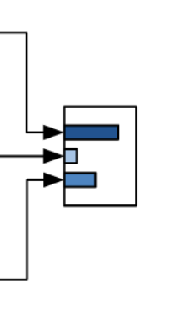
Learning process $ℒ=−log⁡(P\left(w_{t} | w_{t−2,}w_{t−1},w_{t+1},w_{t}\right))$
source: https://lilianweng.github.io/lil-log/2017/10/15/learning-word-embedding.html
Notes:
Use softmax cross entropy loss
Minimize – log p probability of the context world
Unsupervised learning process from large corpora

Slide 11
source: https://opensource.googleblog.com/2013/08/learning-meaning-behind-words.html

Slide 12
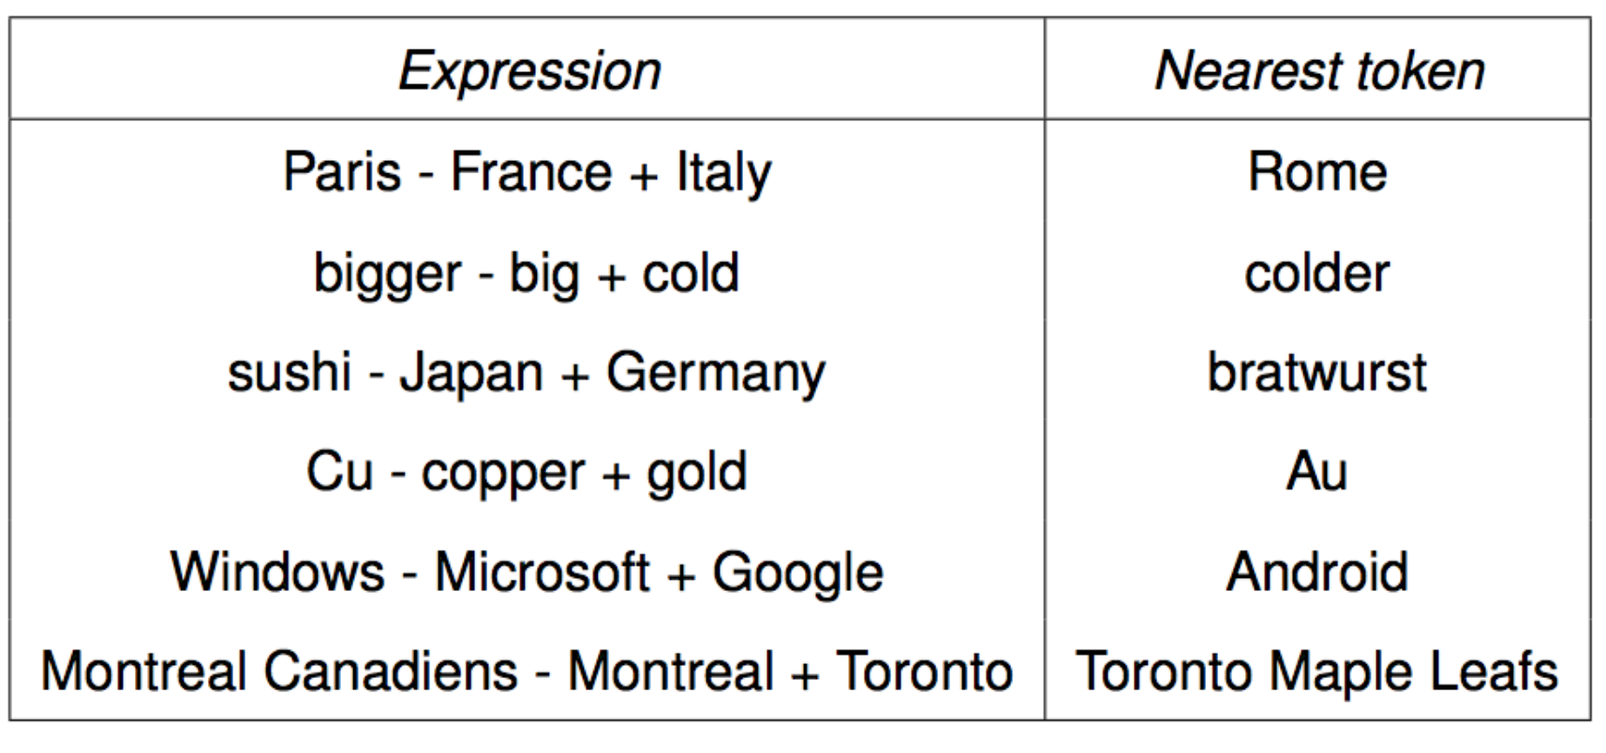

Slide 13

“You can’t cram the meaning of a whole %&!$# sentence into a single $&!#* vector!”
– random guy at ACL 2014 workshop

Slide 14
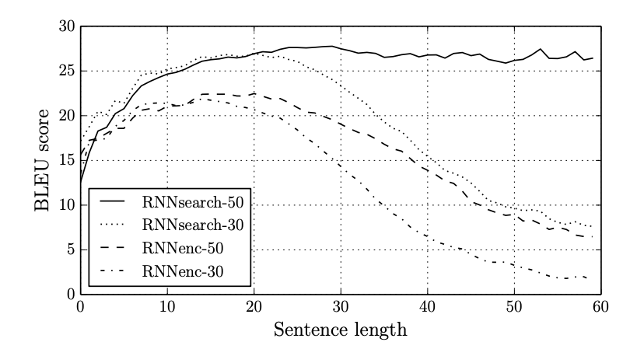
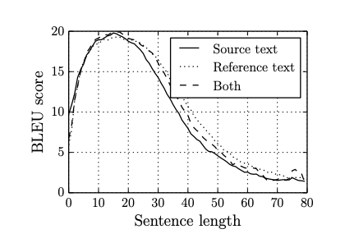
Attention
Problem
Seq2seq context vector has trouble remembering long input sentences
*Bahdanau et al. 2015 – “Neural Machine Translation by Jointly Learning to Align and Translate”
*Cho et al. 2014 – “On the Properties of Neural Machine Translation: Encoder–Decoder Approaches”
Solution
Attention* based models create learned attention vector that measures how much a single word or pixel ”attends” with the other input
*Bahdanau et al. 2015 – “Neural Machine Translation by Jointly Learning to Align and Translate”

Slide 15


Slide 16
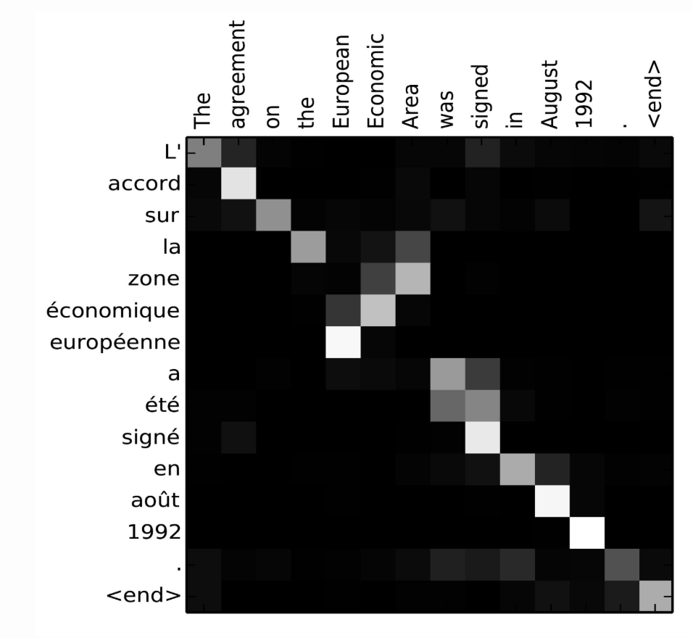

What does this look like?
$α_{t,i}$ - visualized

Slide 17
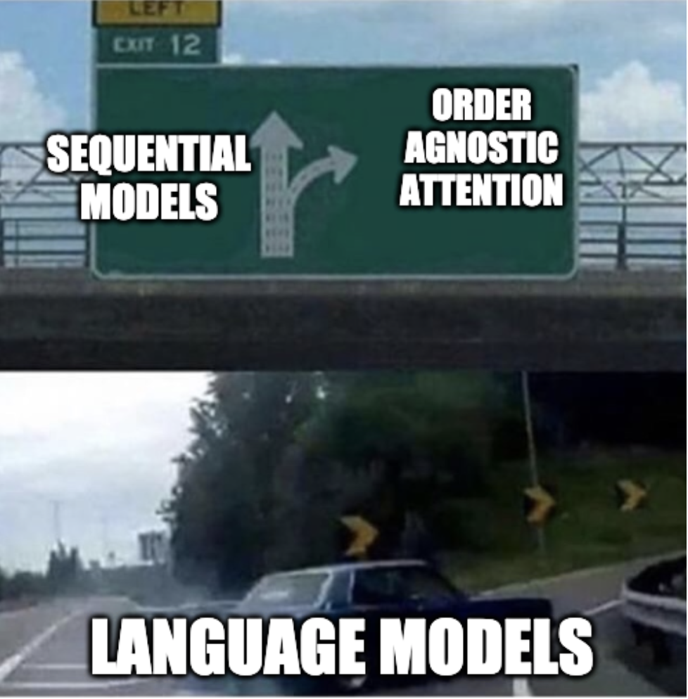

Slide 18
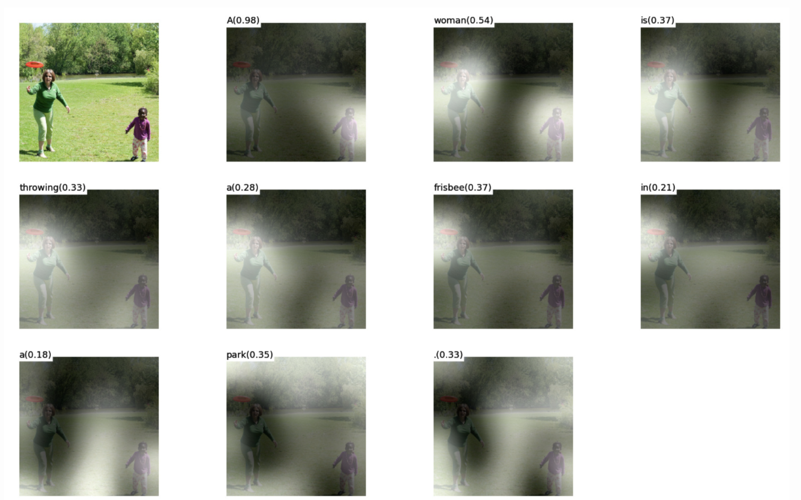
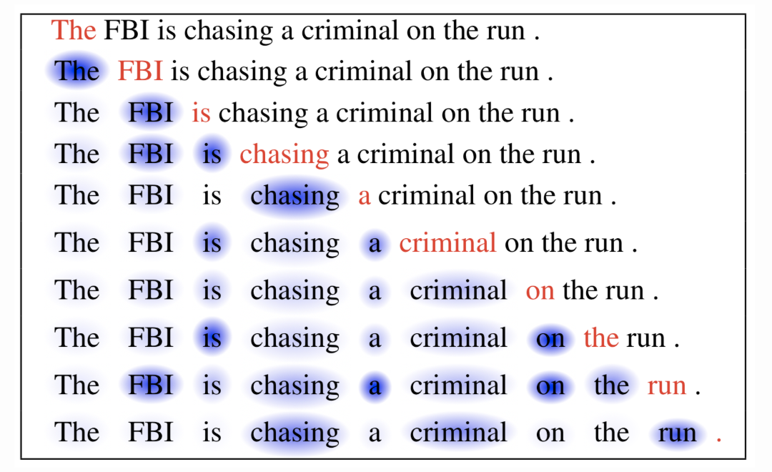
Self-attention
*Dong and Lapata. 2016 – “Long Short-Term Memory-Networks for Machine Reading”
*Xu et al. 2015 – “Show, Attend and Tell: Neural Image Caption Generation with Visual Attention”

Slide 19
Self-attention on sentence Self-attention: “The apple is red, it is delicious”
The
apple
is
red
,
it
is
delicious
The
apple
is
red
,
it
is
delicious
The
apple
is
red
,
it
is
delicious

Slide 20
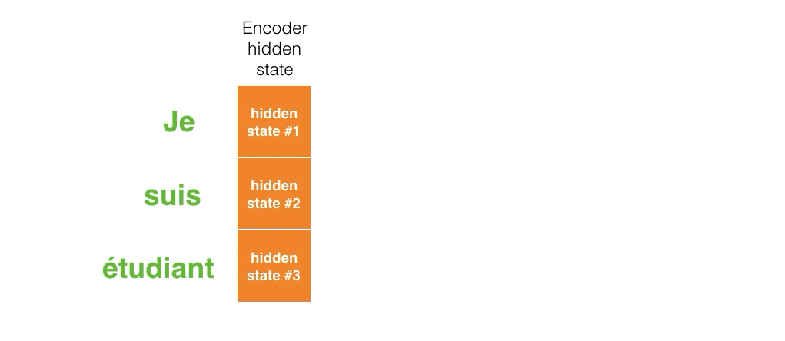

Slide 21
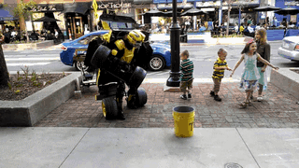

Slide 22
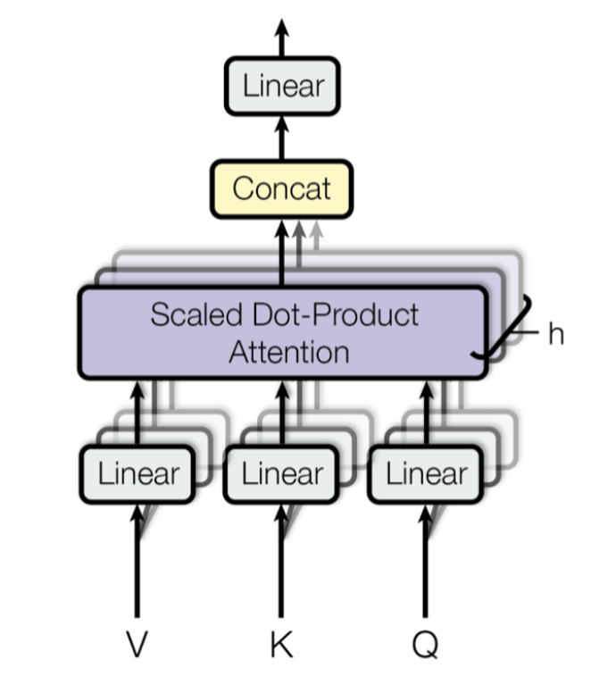
Transformer
Why bother with RNNs at all?
Transformer is built entire on self-attention mechanisms through “multi-head self-attention”
Vaswani, et al., 2017 - “attention is all you need”

Slide 23
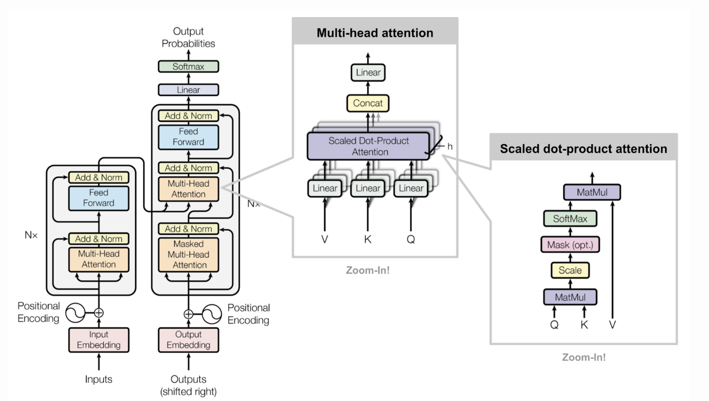

Slide 24
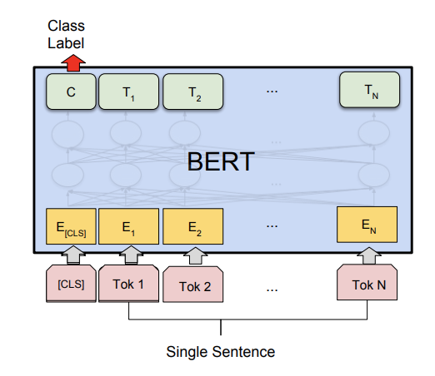
BERT (Devlin et al. 18)
Bidirectional Encoder Representations from Transformers (BERT)

Slide 25
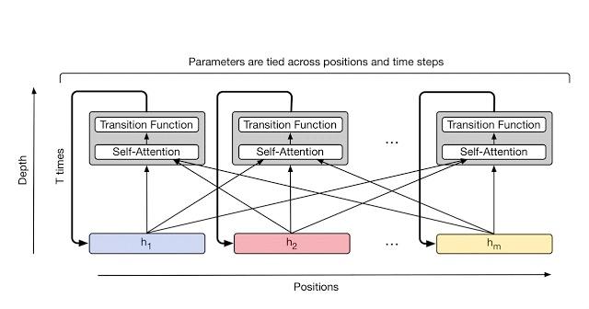
BERT (Devlin et al. 18) Inspired by “Improving Language Understanding by Generative Pre-Training”, Radford et al. 2018 GPT-1 OpenAI
Based on Transformer and the multi-head self-attention model
Source: https://lilianweng.github.io/lil-log/2018/06/24/attention-attention.html

Slide 26
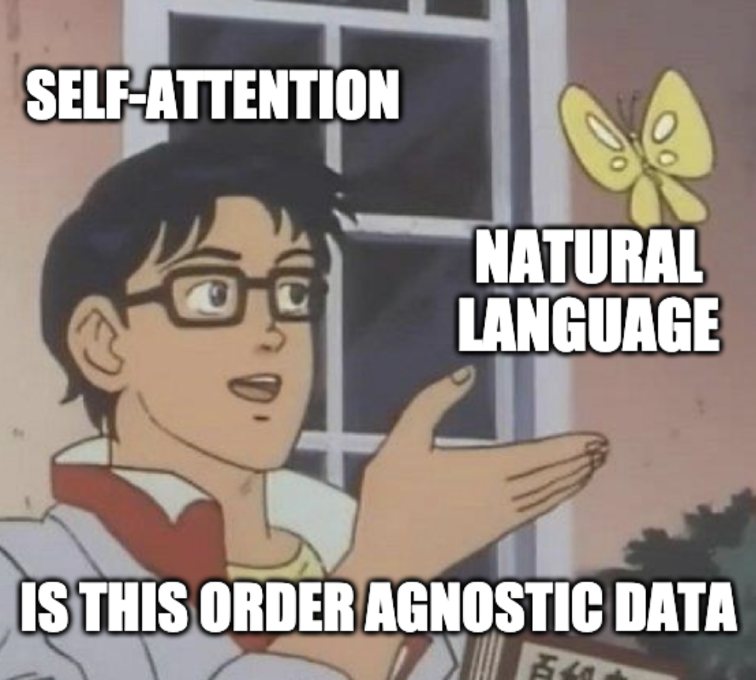

Slide 27
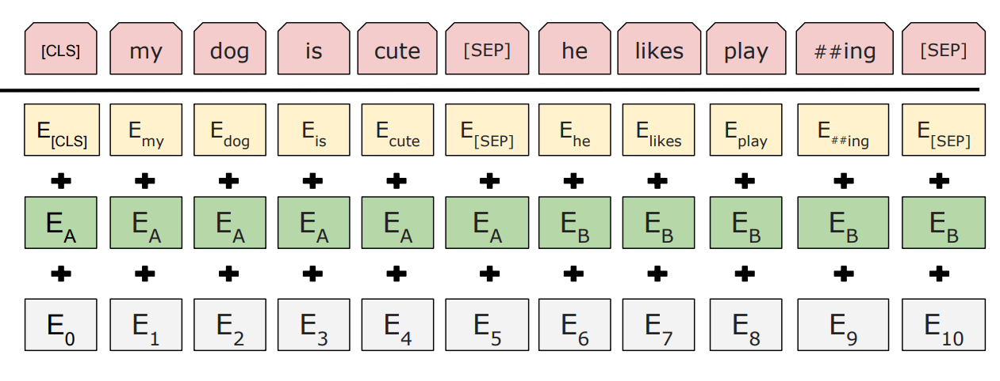
BERT (Devlin et al. 18)
BERT INPUT REPRESENTATION:
INPUT
MASK
WordPieces Embeddings
E_{MASK}
Sentence
Embeddings
Position
Embeddings
Learned during the (pre)training process
In pre-training 15% of the input tokens are masked for the masked LM task
Notes:
Task 1: Mask language model (MLM)
Task 2: Next sentence prediction
Note that the first token is always forced to be [CLS] — a placeholder that will be used later for prediction in downstream tasks.

Slide 28
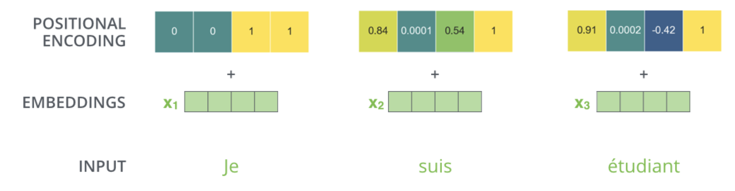

Positional embedding
Self-attention only uses feedforward neural networks. No RNN based architecture means positional information is not passed.
Solution
sine-cosine-wave-based positional encoding summed to embedding output
$${PE}_{(pos,2i)}=sin⁡(pos/{10000}^{2i/d_{model}}$$
$${PE}_{(pos,2i+1)}=cos⁡(pos/{10000}^{2i/d_{model}}$$

Slide 29
Decoding strategies
Greedy decoding
- Simple argmax on probability distribution.
Beam Search
Look at top-k most probable options
Run next time-step decoding with all ’k’ options
After n iterations (beam size) compare score and keep the max.

Slide 30
OpenAI GPT-2 (Radford et al. 19) Language Models are Unsupervised Multitask Learners
Trained on language model task
40GB corpus dataset
1.5B parameters
Source: original paper

Slide 31
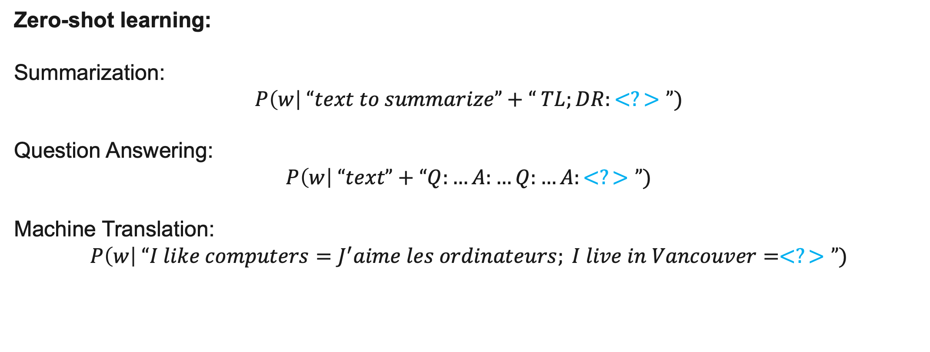
OpenAI GPT-2 (Radford et al. 19) Language Models are Unsupervised Multitask Learners
All the downstream language tasks are framed as predicting conditional probabilities and there is no task-specific fine-tuning.
Zero-shot learning:
Summarization:
$$P\left(w\right| “text to summarize”+“ TL;DR:<?>”)$$
Question Answering:
$$P\left(w\right| “text”+“Q:…A:…Q:…A:<?>”)$$
Machine Translation:
$$P\left(w\right| “I like computers=J^{′}aime les ordinateurs; I live in Vancouver=<?>”)$$

Slide 32
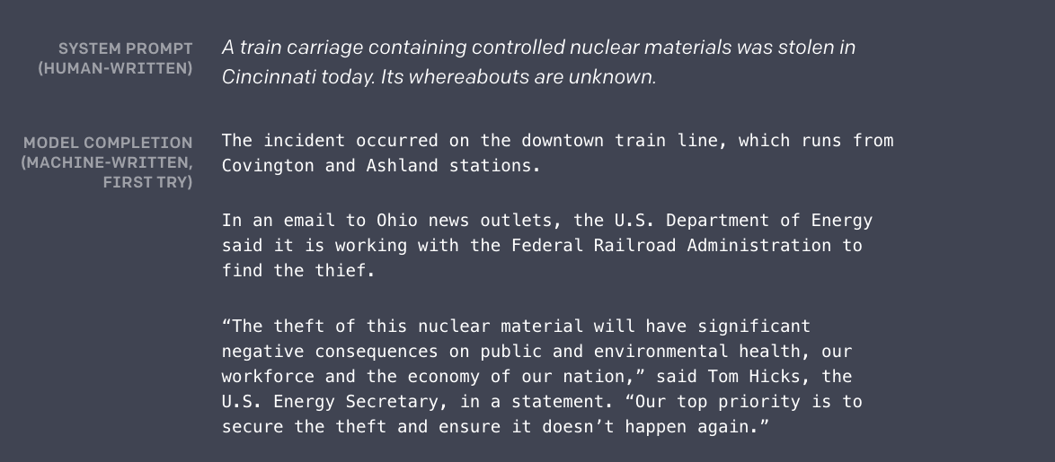
Source: https://blog.openai.com/better-language-models/

Slide 33
roBERTa: A Robustly Optimized BERT Pretraining Approach
BERT pre-training not optimized
1. training the model longer, with bigger batches, over more data
2. removing the next sentence prediction objective
3. training on longer sequences
4. dynamically changing the masking pattern applied to the training data.
Was SOTA until 3 days ago – Google released ALBERT

Slide 35
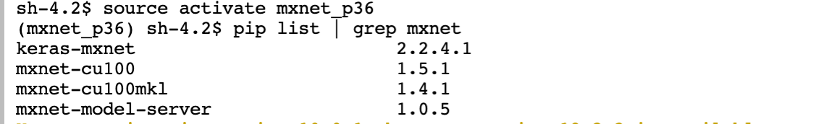
roBERTa Lab
Notebook: http://tinyurl.com/y33vgk6m

Slide 36

Questions?

